Slide 1
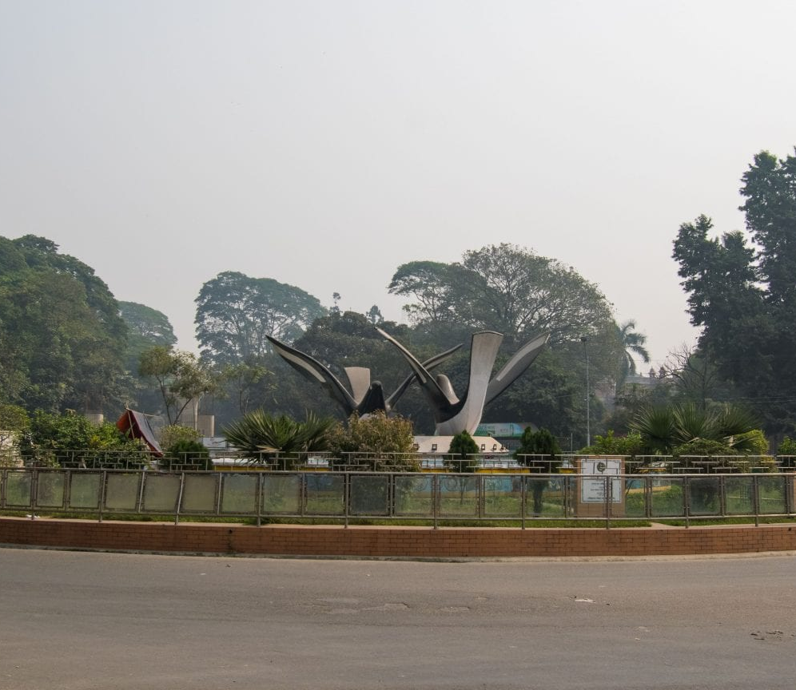
Traffic Light Simulation for Doel Chottor
Using Digital Logic Circuits and RGB LEDs
Presented By
Kazi Ishrak Ahmed - 1706077
Monir Hossain Afif – 1706091
Tasnim Nishat Islam Manami – 1706092
Tahsin Saad - 1706095

Slide 2
Objective
To Design Automated Traffic Control with RGB LEDs and only Digital Logic Circuits
Features
Traffic light of each junction with red, yellow and green implemented
Pedestrian crossing for each road defined
Pedestrians are guided with red (wait) or cross (Blue) light
Yellow light implemented
The remaining time of red signal using a 7-segment display displayed for one signal
Signals can be manually switched with a push button

Slide 3
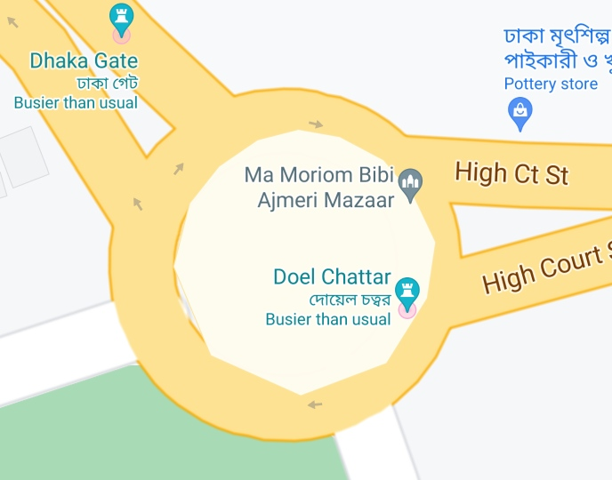
Doel Chottor
Doel chottor is a roundabout with 4 entryways.
The roads that enter the roundabout are-
University St.
Secretariate Rd.
High Court Rd.
Curzon Hall Rd.
All of the roads are 2-lane both way roads

Slide 4

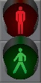
Traffic Light Positions

Slide 5
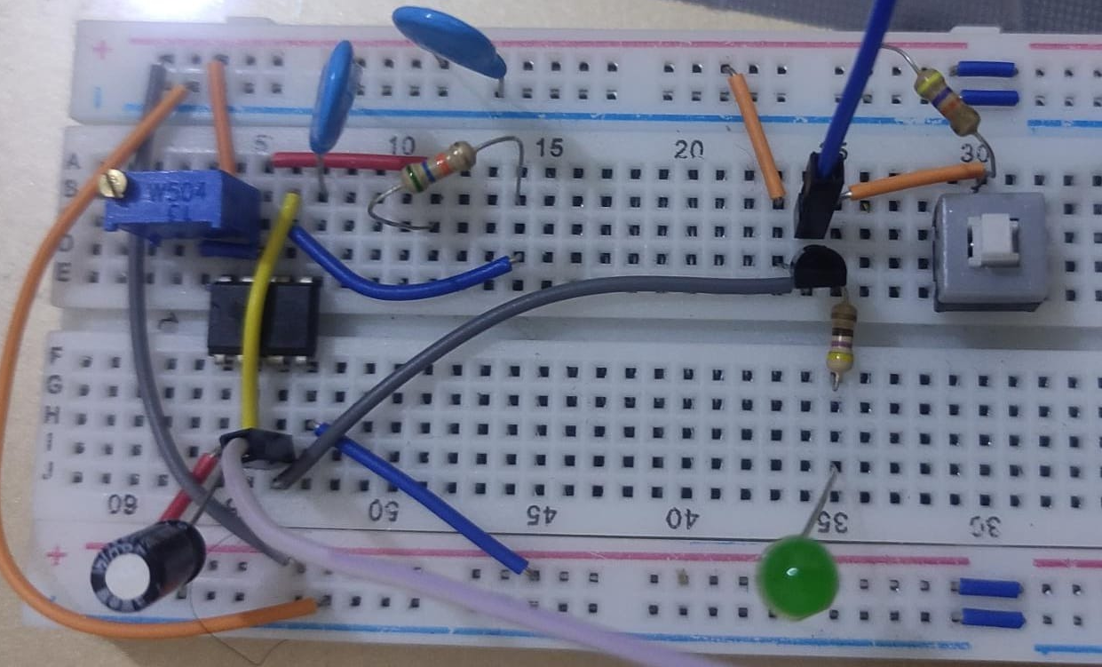
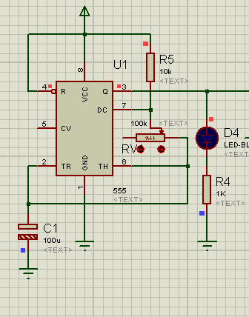
Traffic light of each junction with RGB
555 Timer
Using the following eqn., we made a timer for 1s clock pulse.
T=(R1+2R2)C2

Slide 6
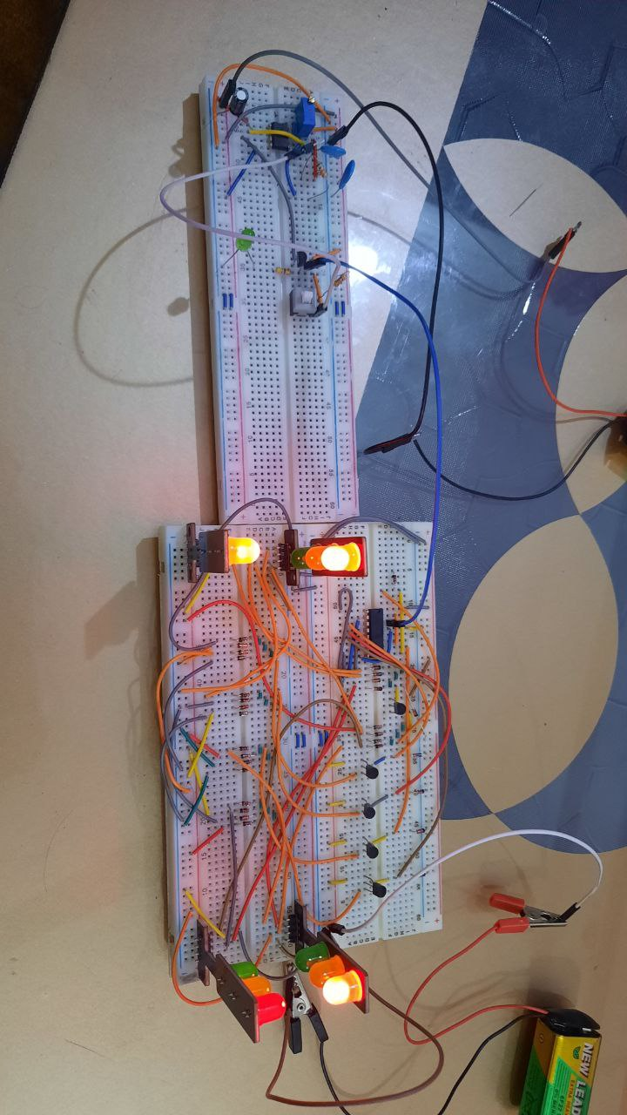
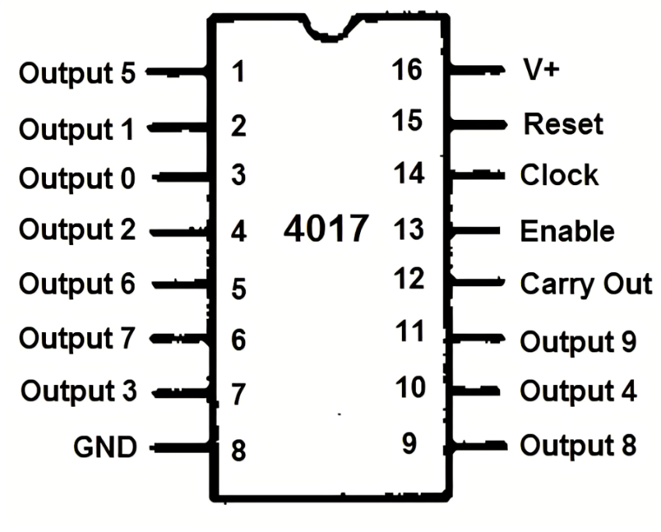
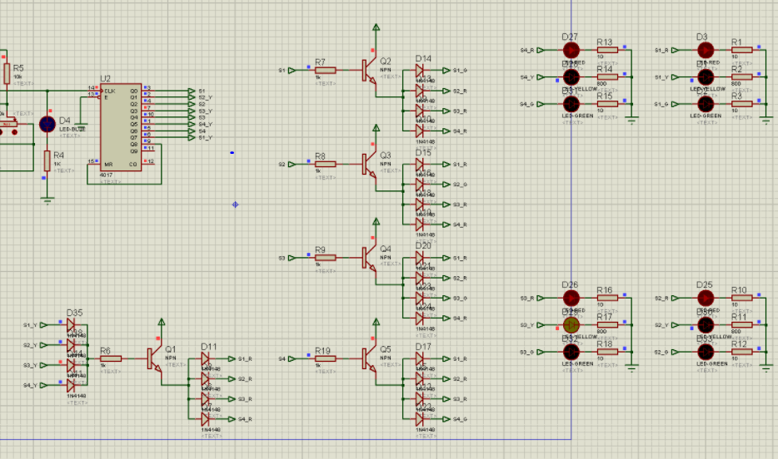
Traffic light of each junction with RGB
Digital logic schematic of the traffic lights

Slide 7


Slide 8
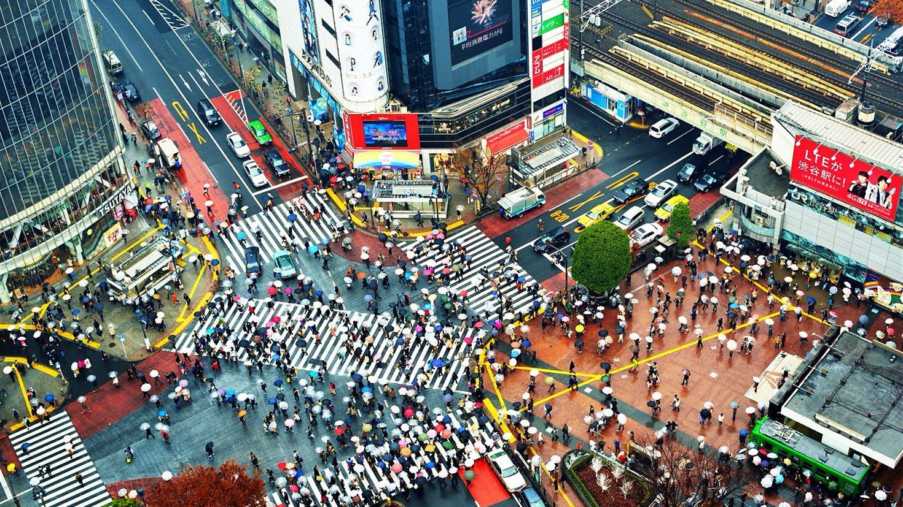
Pedestrian Lights

Slide 9
Pedestrian Lights

Slide 10
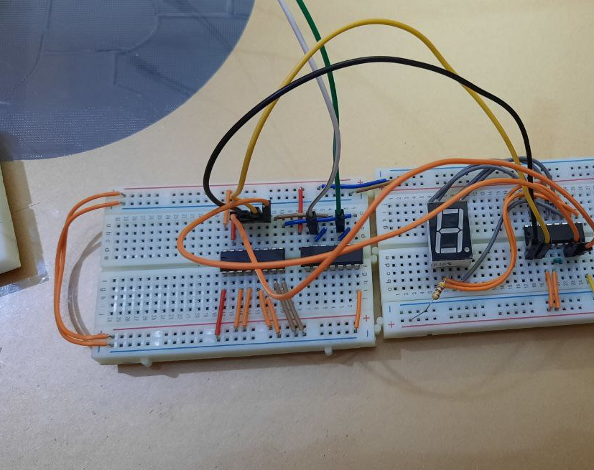
Remaining Time Display

Slide 11

Manual Switching

Slide 12
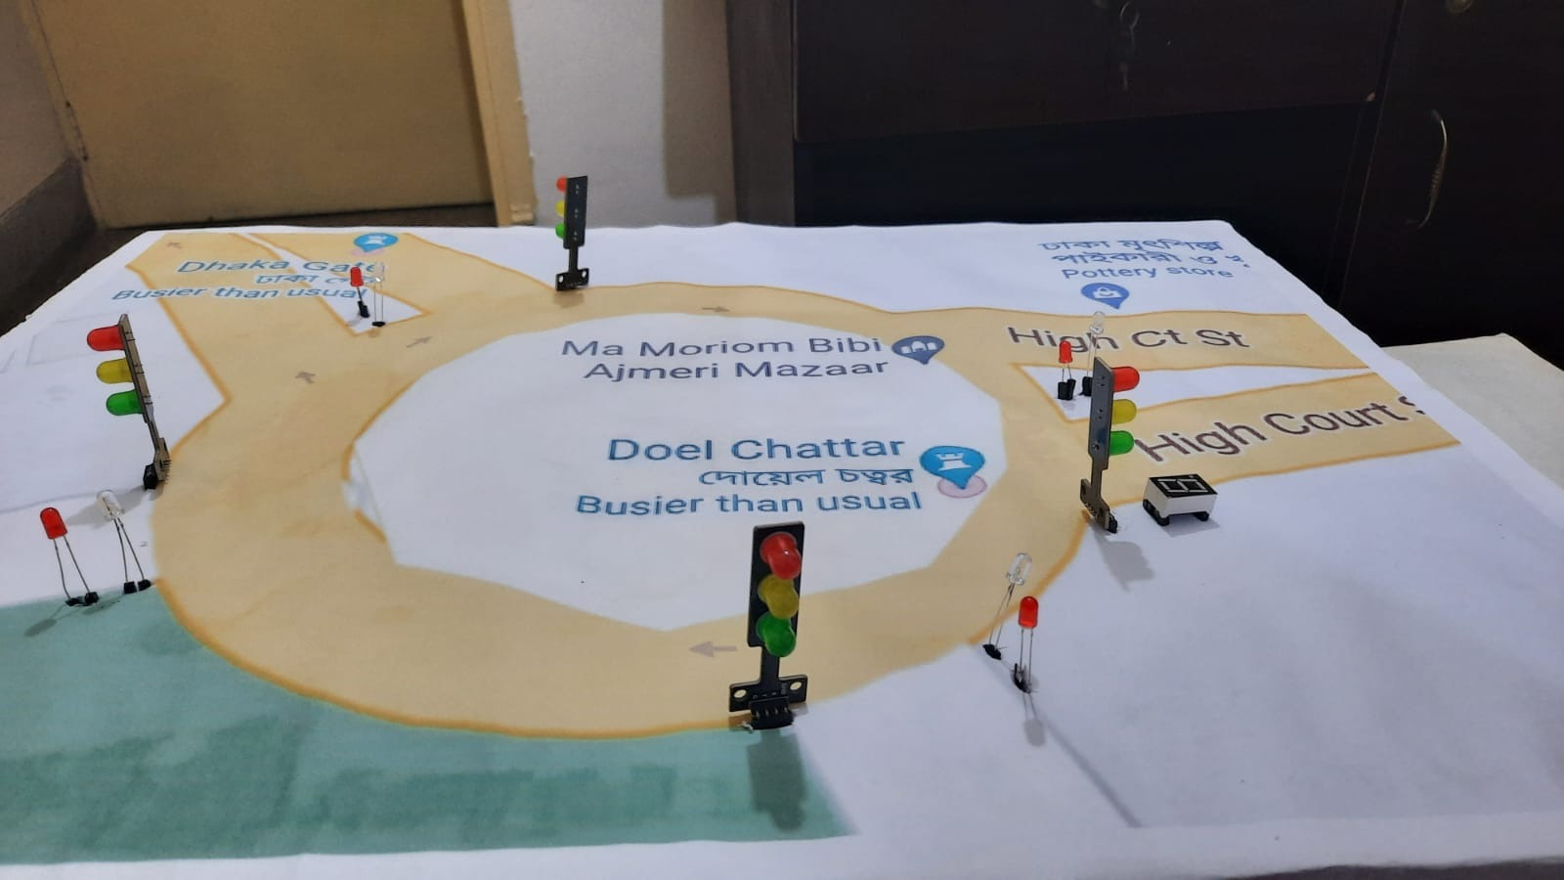
Final Assembly

Slide 13
Individual Demonstration

Slide 14

Thank You!
May the force be with us!

